Slide 1


Joshua Le Cornu
20/09/2022

Slide 2

Outline
Executive Summary
Introduction
Methodology
Results
Conclusion
Appendix

Slide 3
Executive Summary
Summary of methodologies
Collecting Data via an API and webscraping
Wrangling the data with SQL and Python / Pandas
EDA with SQL, Pandas and Matplotlib
Interactive dashboarding with Plotly Dash
Predictive analysis using classification ML techniques
Summary of all results
Final accuracy of 83.3% in classification model

Slide 4
Introduction
Project background and context
Predict if the Falcon 9 first stage will land successfully.
Cost of 62 million dollars vs other providers cost upward of 165 million dollars each, much of the savings is because SpaceX can reuse the first stage.
If the first stage will land, we can determine the cost of a launch.
Problems you want to find answers
What is the success rate of launches?

Slide 5

Section 1

Slide 6
Methodology
Executive Summary
Data collection methodology:
Data was collected using a REST API linked to webhook for Falcon launch data
Perform data wrangling
Processed in SQL using functions like SELECT, MAX etc.
Perform exploratory data analysis (EDA) using visualization and SQL
Perform interactive visual analytics using Folium and Plotly Dash
Perform predictive analysis using classification models
Grid search over parameters, trial of different algorithms

Slide 7
Data Collection
Describe how data sets were collected.
Data was collected using a REST API linked to webhook for Falcon launch data
You need to present your data collection process use key phrases and flowcharts

Slide 8
Setup Functions to get request library
Feed urls and REST API details
Check response content
Parse response to json
Normalize
Convert to data frame
Data Collection – SpaceX API
Present your data collection with SpaceX REST calls using key phrases and flowcharts
Add the GitHub URL of the completed SpaceX API calls notebook (must include completed code cell and outcome cell), as an external reference and peer-review purpose
https://eu-de.dataplatform.cloud.ibm.com/analytics/notebooks/v2/d36d25e4-c686-4744-86f8-9a8fd070205f/view?access_token=f5fdc3c74637a6534c99681c1399ad1c18874b042f9c15ef725816a258c711e0
Place your flowchart of SpaceX API calls here

Slide 9
Extract html record from Wikipedia
Use beautiful soup library to parse html response
Get urls and setup packages
Extract column names
Parse tables to dataframes
Data Collection - Scraping
Present your web scraping process using key phrases and flowcharts
Add the GitHub URL of the completed web scraping notebook, as an external reference and peer-review purpose
https://eu-de.dataplatform.cloud.ibm.com/analytics/notebooks/v2/fde8395e-cf21-4a61-9b91-ea02d1434e1c/view?access_token=a7c9a41b8acd18c60b0b346d5d2414b2145ddb1db1fb7a59b4655111d0921641
Place your flowchart of web scraping here

Slide 10
Data Wrangling
Describe how data were processed
You need to present your data wrangling process using key phrases and flowcharts
Add the GitHub URL of your completed data wrangling related notebooks, as an external reference and peer-review purpose
https://eu-de.dataplatform.cloud.ibm.com/analytics/notebooks/v2/6bd7de8b-20c1-4865-b703-8616cd7cf888/view?access_token=1af07bfdee596c18bf93cb77cd8bc575696f4863befcc1be9ff52f4e6c57dd31
Pandas to read csv files
Orbit count by number and occurrence
Compute success rate
Deal with missing values
Value counts for each site
Split statistics by mission outcome

Slide 11
EDA with Data Visualization
Summarize what charts were plotted and why you used those charts
Show all launch sites to assess scope and locations
Mark success and fails launches per site on map
Compute distances between launch sites and proximities
Discovered some geographical patterns about launch sites → e.g. links to coastal and equator line, far from cities and highways, railways etc.
Add the GitHub URL of your completed EDA with data visualization notebook, as an external reference and peer-review purpose
https://eu-de.dataplatform.cloud.ibm.com/analytics/notebooks/v2/e8c749ab-87b2-425e-ba67-92b48979e115/view?access_token=7f9dfe572ff23b1e10ec9402471cc8c4a7c3260774b4cc04c879a2e72d1861c7

Slide 12
EDA with SQL
Using bullet point format, summarize the SQL queries you performed
%sql select Unique(LAUNCH_SITE) from SPACEXTBL;
%sql SELECT LAUNCH_SITE from SPACEXTBL where (LAUNCH_SITE) LIKE 'CCA%' LIMIT 5;
%sql select sum(PAYLOAD_MASS__KG_) as payloadmass from SPACEXTBL;
%sql select avg(PAYLOAD_MASS__KG_) as payloadmass from SPACEXTBL;
%sql select min(DATE) from SPACEXTBL;
%sql select BOOSTER_VERSION from SPACEXTBL where LANDING__OUTCOME='Success (drone ship)' and PAYLOAD_MASS__KG_ BETWEEN 4000 and 6000;
%sql select count(MISSION_OUTCOME) as missionoutcomes from SPACEXTBL GROUP BY MISSION_OUTCOME;
%sql select BOOSTER_VERSION as boosterversion from SPACEXTBL where PAYLOAD_MASS__KG_=(select max(PAYLOAD_MASS__KG_) from SPACEXTBL);
%sql SELECT MONTH(DATE),MISSION_OUTCOME,BOOSTER_VERSION,LAUNCH_SITE FROM SPACEXTBL where EXTRACT(YEAR FROM DATE)='2015';
%sql SELECT LANDING__OUTCOME FROM SPACEXTBL WHERE DATE BETWEEN '2010-06-04' AND '2017-03-20' ORDER BY DATE DESC;
Add the GitHub URL of your completed EDA with SQL notebook, as an external reference and peer-review purpose
https://eu-de.dataplatform.cloud.ibm.com/analytics/notebooks/v2/b95b0137-77b4-4042-aa55-7c72c202b548/view?access_token=b52fdd9824e7ba5e98a45b8dfe6a08dcde9f4c8ac925c2aedebdc1534c3fe484

Slide 13
Build an Interactive Map with Folium
Summarize what map objects such as markers, circles, lines, etc. you created and added to a folium map
Show all launch sites to assess scope and locations
Mark success and fails launches per site on map
Compute distances between launch sites and proximities
Explain why you added those objects
Discovered some geographical patterns about launch sites → e.g. links to coastal and equator line, far from cities and highways, railways etc.
Colouring by success shows clearly which sites are more successful in terms of rate
Add the GitHub URL of your completed interactive map with Folium map, as an external reference and peer-review purpose
https://eu-de.dataplatform.cloud.ibm.com/analytics/notebooks/v2/e8c749ab-87b2-425e-ba67-92b48979e115/view?access_token=7f9dfe572ff23b1e10ec9402471cc8c4a7c3260774b4cc04c879a2e72d1861c7

Slide 14
Build a Dashboard with Plotly Dash
Summarize what plots/graphs and interactions you have added to a dashboard
Explain why you added those plots and interactions
Add the GitHub URL of your completed Plotly Dash lab, as an external reference and peer-review purpose

Slide 15
Predictive Analysis (Classification)
Standardize data
Train test split to get unbiased test error estimates
Choose model type (repeated)
Feature engineering / preprocessign for model input
Grid search and cross validation for parameters / tuning
Model fit
Result tested and scores
Confusion matrix
Summarize how you built, evaluated, improved, and found the best performing classification model
You need present your model development process using key phrases and flowchart
Add the GitHub URL of your completed predictive analysis lab, as an external reference and peer-review purpose
https://eu-de.dataplatform.cloud.ibm.com/analytics/notebooks/v2/161e9591-3c3c-4abc-a698-1ef646032f35/view?access_token=ac7a174a3df24cea6f0b5ad6f67f7b62fb95d693c0472fff0e15c9eed508101f

Slide 16

Section 2

Slide 17
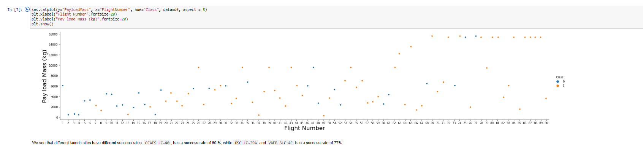
Flight Number vs. Launch Site
Show a scatter plot of Flight Number vs. Launch Site
Show the screenshot of the scatter plot with explanations

Slide 18
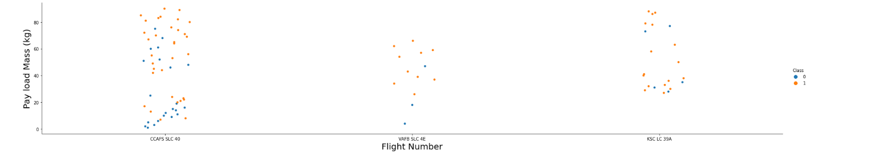
Payload vs. Launch Site
Show a scatter plot of Payload vs. Launch Site
Clustering in payload across sites, lots of small payload failues in SLC 40

Slide 19
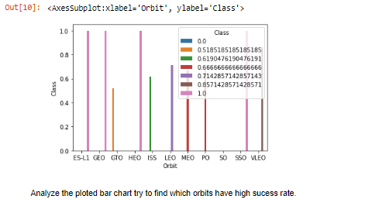
Success Rate vs. Orbit Type
Show a bar chart for the success rate of each orbit type
Show the screenshot of the scatter plot with explanations

Slide 20
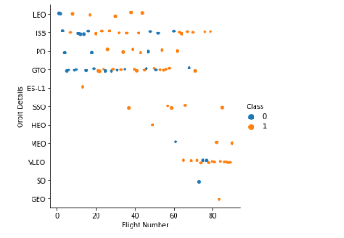
Flight Number vs. Orbit Type
Show a scatter point of Flight number vs. Orbit type
Show the screenshot of the scatter plot with explanations
You should see that in the LEO orbit the Success appears related to the number of flights; on the other hand, there seems to be no relationship between flight number when in GTO orbit.

Slide 21
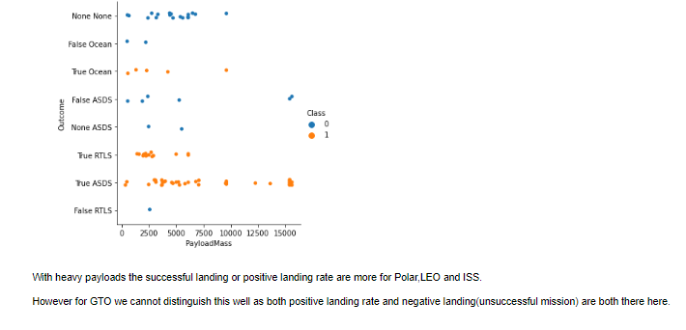
Payload vs. Orbit Type
Show a scatter point of payload vs. orbit type
Show the screenshot of the scatter plot with explanations

Slide 22
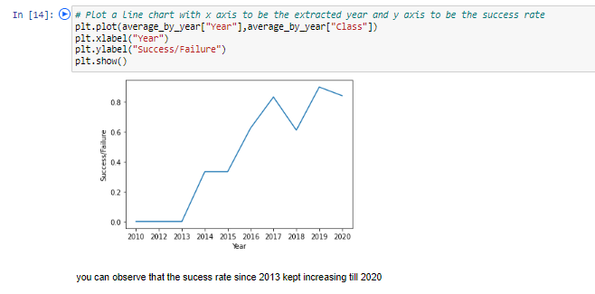
Launch Success Yearly Trend
Show a line chart of yearly average success rate
Show the screenshot of the scatter plot with explanations

Slide 23

Section 3

Slide 24
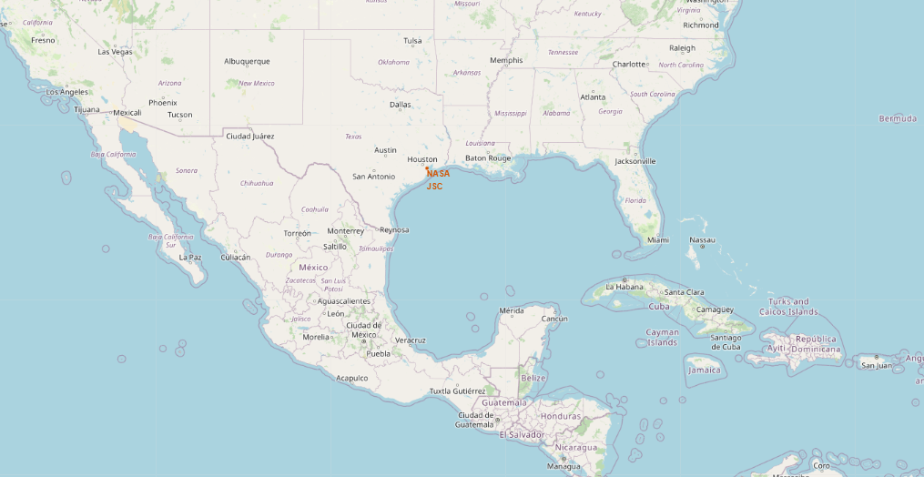
NASA and JSC Locations
Coastal
Rural

Slide 25
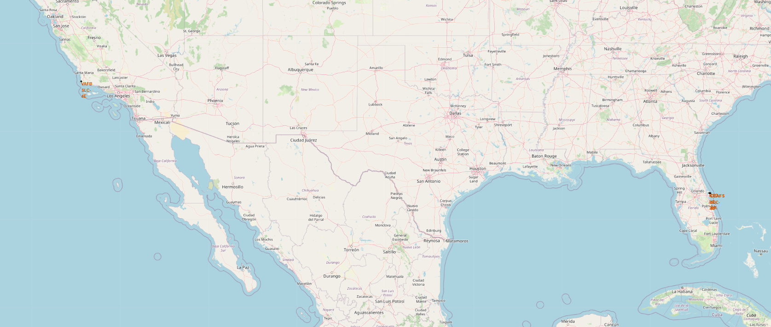
Detailed Launch Sites of SpaceX
Coastal regions
Away from cities
Clustered otgether

Slide 26
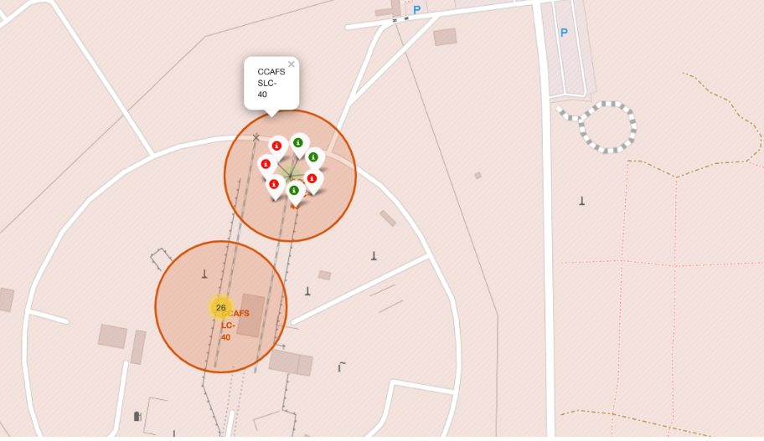
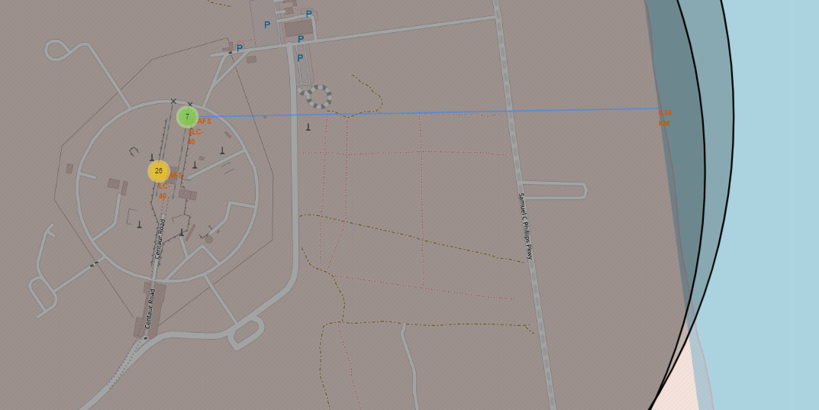
Colour Tagging and Distance Shows Success rates

Slide 27

Section 5

Slide 28
Classification Accuracy
Visualize the built model accuracy for all built classification models, in a bar chart
Find which model has the highest classification accuracy

Slide 29
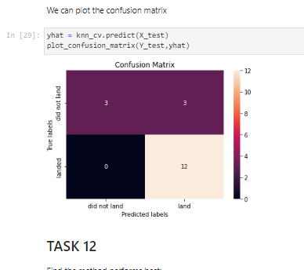
Confusion Matrix
Show the confusion matrix of the best performing model with an explanation

Slide 30
Conclusions
KNN Best – suggests non linear relations between success and sites
Imbalance in confusion matrix, suggests some model biases towards the landed missions → false classifcations all occurring on the false positives
Other models similar in performance

Slide 31


